Slide 1


Start Smart 1.0
4th Grade
Lesson 11

Slide 2

ELD Objective
ELD Objective: Students will be able to engage in a Constructive Conversation using the Constructive Conversation Skill of NEGOTIATE, by taking turns, sharing ideas and making ideas clearer with a partner based on a visual text.

Slide 3
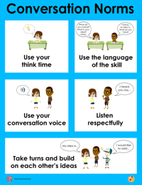
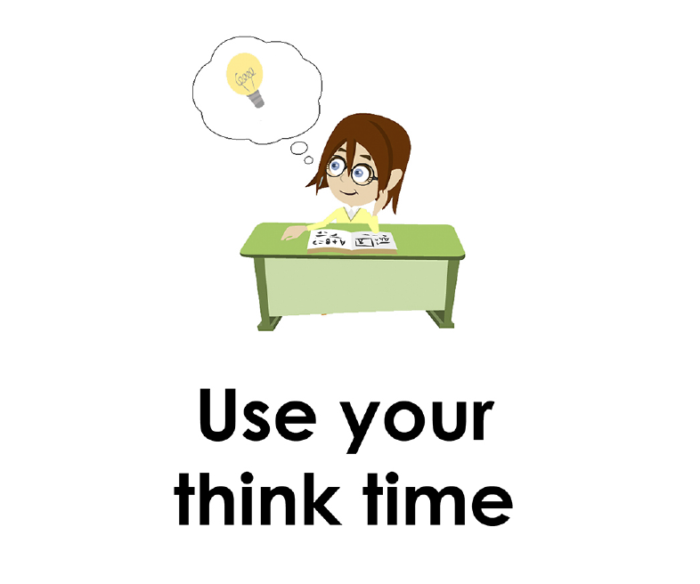
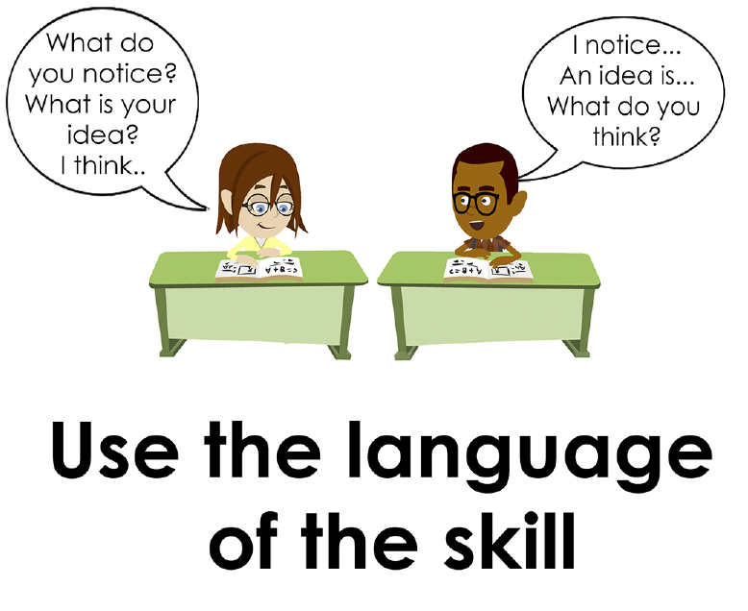
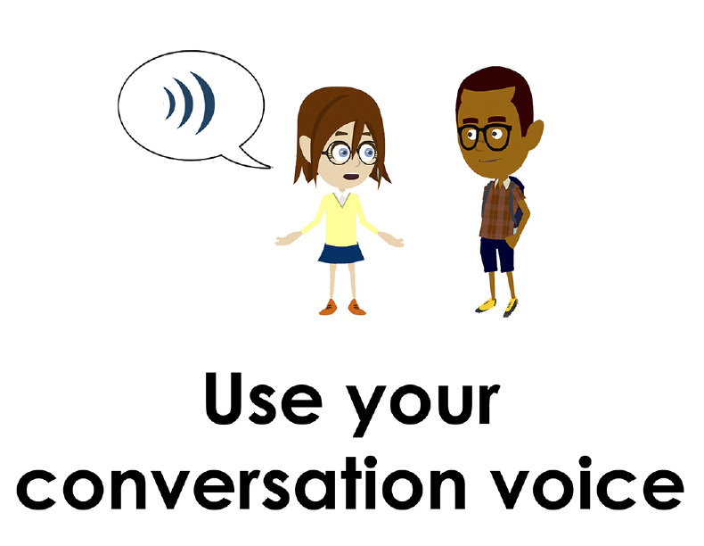
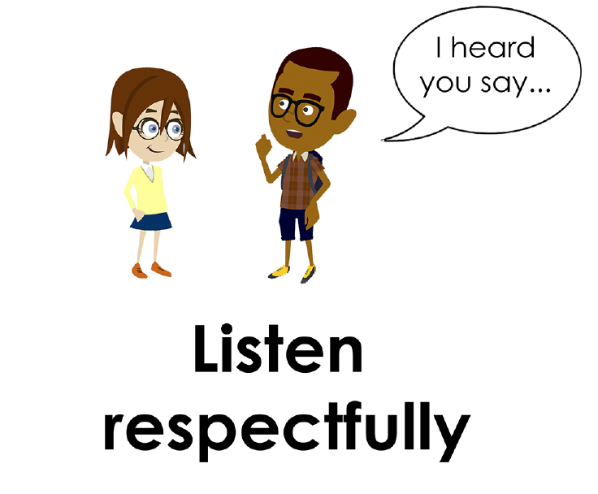
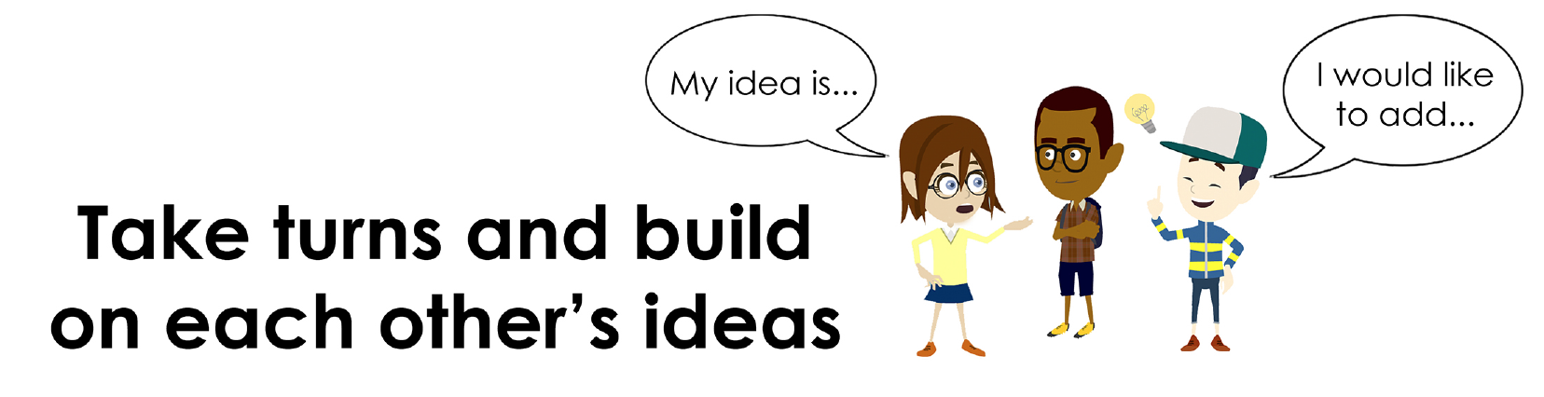
Conversation Norms Poster
  Use your think time
  Use the language of the skill
  Use your conversation voice
  Listen respectfully
  Take turns and build on each other’s ideas

Slide 4
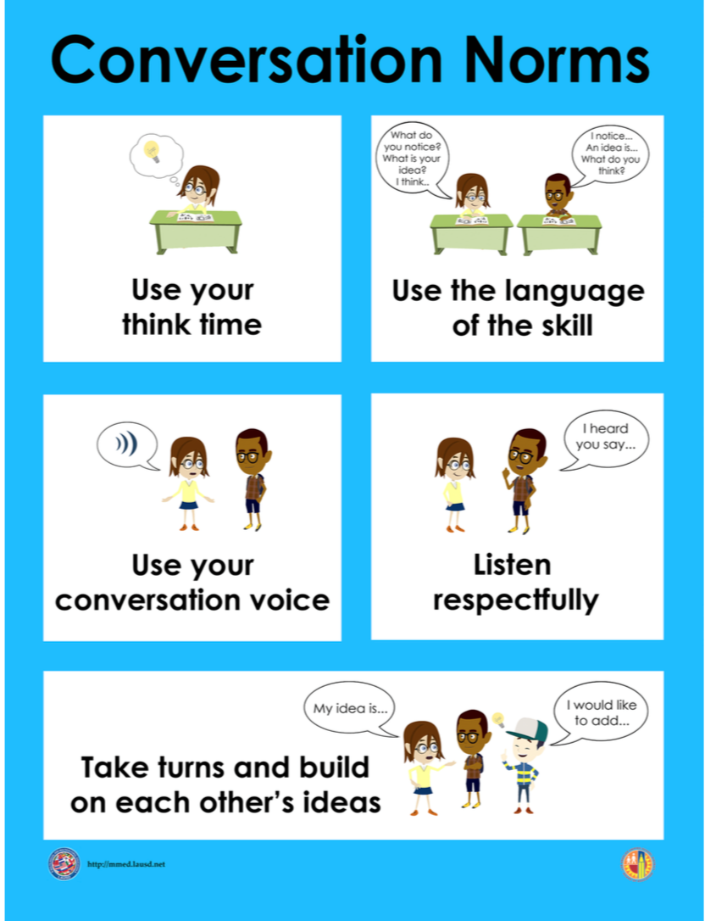
Notes:
The focus today is:
Use your think time
Use the language of the skill

Slide 5
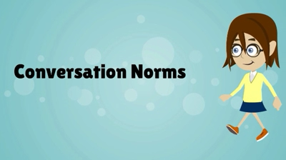
Conversation Norms
Notes:
Show Constructive Conversation Norms Video as a review of all norms

Slide 6
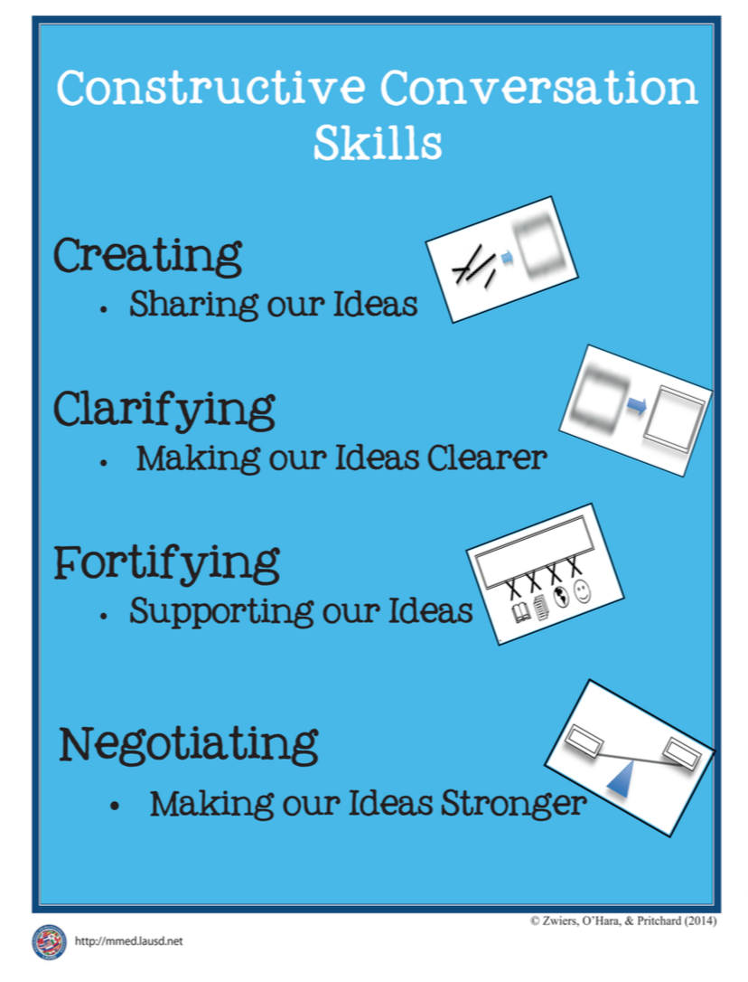
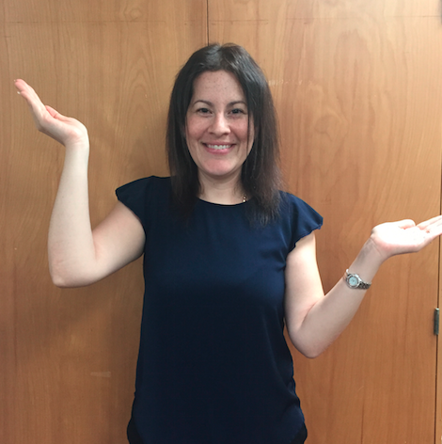
Hand Gesture and Phrase- NEGOTIATE
Making our Ideas Stronger
Notes:
Model NEGOTIATE and have participants repeat with you:
Place hand, palm down in front of you as if putting an idea on the table. Use four fingertips of the other hand to support the palm.

Slide 8
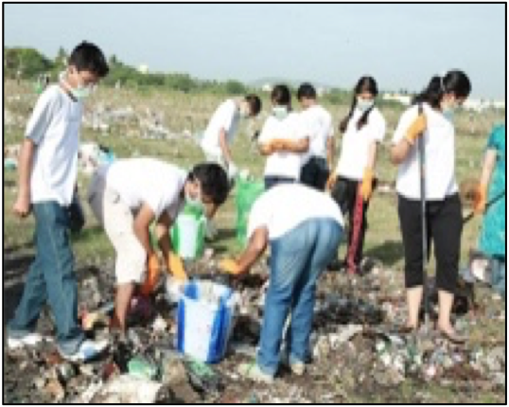
Prompt: What is an important idea from this text? Start by stating your claim. Support your claim and come to a consensus.
TEACHER VISUAL TEXT

Slide 9


Listen to the Model Constructive Conversation
  Use your think time to study the visual text.
Listen actively to what two partners say to each other.
Notes:
Provide a copy of the Model Script to the volunteer and allow time beforehand for student to review the script. Suggestions for reading the script:
● Show a video of students having the model conversation (optional)
● Student volunteer and teacher read model script
STUDENT LISTEN ACTIVELY

Slide 10
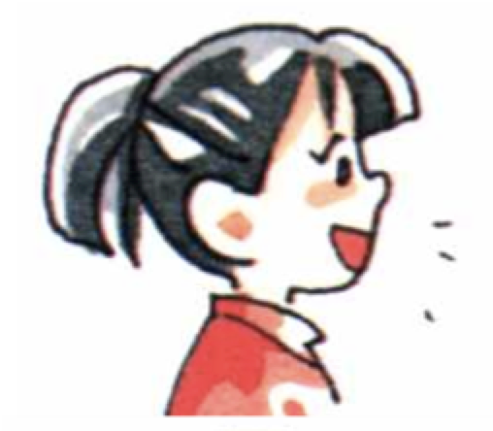
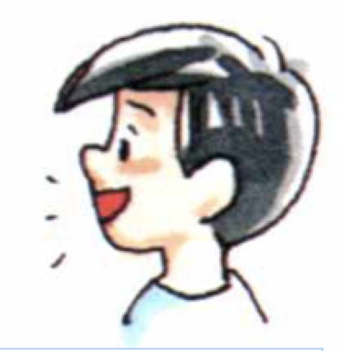
Visual Text Model
What is an important idea from this text? Start by stating your claim. Support your claim and come to a consensus.
Partner A: My claim is that we must all help clean the earth. What is your claim?
Partner A: I agree with your claim. When helping to clean up the earth, you should work with many people. I see a few people in the visual text.
They seem to be working together doing the same things. For example, two kids in the front are placing items into the bucket. What evidence are you using to support your claim?
Partner A: I think the teenagers are also working together by wearing white T-shirts that they can use to identify the people in their group.
Partner A: I think we need to help our Earth by cleaning it up with others. Can we come to a consensus?
Partner B: My claim is that an environmental clean-up requires a lot of people working together. How can you support your claim with evidence?
Partner B: I notice all the teenagers are wearing gloves and face masks. They also have rakes and containers in which to place the trash they are picking
up. I think they worked together to bring tools they can use to clean up the field. What other evidence from the visual text supports your claim?
Partner B: I think this group of teenagers are working together so they can work faster and clean up a bigger area. How can we come to a consensus?
Partner B: The important idea we came to a consensus on is that in order to clean up the earth you have to work together with others to make significant changes.

Slide 12
Listen to the Non-Model Constructive Conversation
  Use your think time to study the visual text.
Listen actively to what two partners say to each other.
Notes:
Provide a copy of the Non-­‐‑Model Script to the volunteer and allow time beforehand for student to review the script. Suggestions for reading the script:
● Show a video of students having the model conversation (optional)
● Student volunteer and teacher read model script
STUDENT LISTEN ACTIVELY

Slide 13
Visual Text Non- Model
What is an important idea from this text? Start by stating your claim. Support your claim and come to a consensus.
Partner A: I think the kids are cleaning the environment.
Partner A: When you pick up trash you feel better because the earth is cleaner.
Partner A: My brother helps me clean up too.
Partner A: No turn taken
Partner B: I think the same as you. Tell me more about your claim.
Partner B: My mom loves it when I clean the house.
Partner B: We use a bucket to clean up.
Partner B: No turn taken

Slide 14

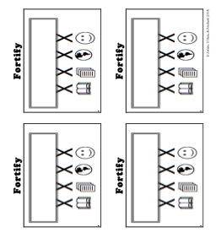
Constructive Conversation Game
PROMPT:
What is an important idea from this text? Start by stating your claim. Support your claim and come to a consensus.
Rules of the game:
Each of you needs 1 CREATE, 1 CLARIFY, 1 FORTIFY, and 2 NEGOTIATE cards
Each of you will play one card as you share an idea. You will continue taking turns until all cards are placed in the middle.
If you’re done early repeat the process for an additional round.
Remember to use the Constructive Conversation Norms and Skills as you play the game.
Notes:
You are now going to have the opportunity to practice the Constructive Conversation Skill NEGOTIATE while playing a game.
Explain the rules of the Constructive Conversation Game to students.

Slide 15
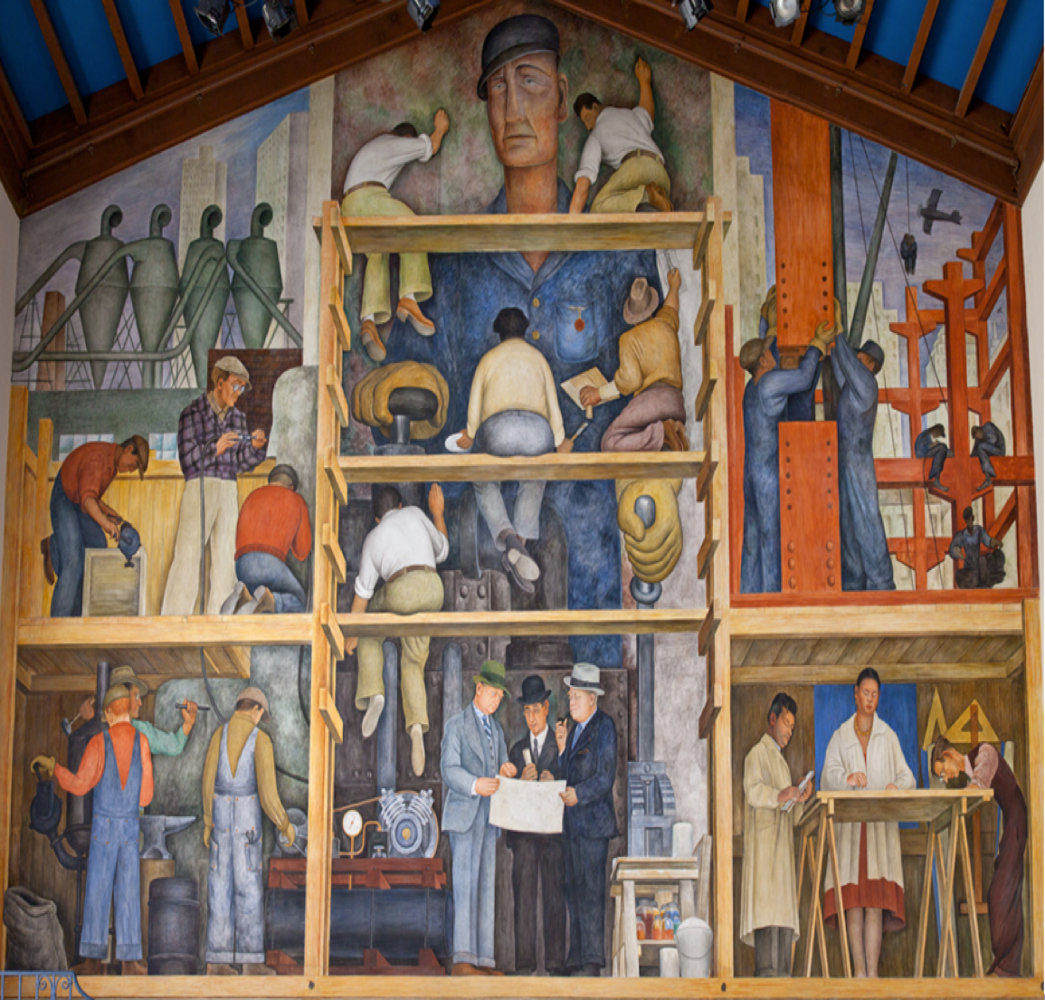

Prompt: What is an important idea from this text? Start by stating your claim. Support your claim and come to a consensus.
TEACHER COLLECTS LANGUAGE SAMPLE SPF 1.0
STUDENT VISUAL TEXT
Notes:
Display the Student Visual Text
Direct students to use their Think Time
As the students play the game, the teacher listens and selects two students who will replay the game in front of the class to serve as models.
This is an opportunity to capture a language sample.

Slide 16


CONSTRUCTIVE CONVERSATION
FISHBOWL MODEL
PROMPT: What is an important idea from this text? Start by stating your claim. Support your claim and come to a consensus.
Listen actively to what two partners say to each other.
FORMATIVE ASSESSMENT– TEACHER COLLECTS LANGUAGE SAMPLE SPF 1.0
Notes:
The two selected students will replay the game in front of the class and serve as models.
Student Progress Form (SPF)-­‐‑ Constructive Conversation Language Sample The teacher will collect a language sample from the two students on the Student Progress Form (SPF)-­‐‑ Constructive Conversation Language Sample to be used in Lesson 2. The language sample must be at least four turns in length. (Each turn includes both Partner A and B sharing

Slide 17
WRAP-UP
How did we meet today’s objective of using the Constructive Conversation Skill of NEGOTIATE?
How did you:
    Use your think time?
    Use the language of the skill
  Work with your conversation partner to do the following:
    Identify three things that you did to meet today’s objective
    Share and explain the three things to your partner
Notes:
Teacher will review ELD objective.
Today we engaged in a Constructive Conversation using the Constructive Conversation Skill-­‐‑NEGOTIATE. We took turns and shared ideas based on a visual text.
Teacher will ask students the following:
● How did we meet today’s objective of using the Constructive Conversation Skill of NEGOTIATE?
● How did you:
-Use your think time
-Use the language of the skill
● Work with your conversation partner to do the following:
Identify three things that you did to meet today’s objective
Share and explain the three things to your partner
Teacher calls on three students and they tell the class what was done today.

Slide 18
Start Smart 1.0
NEGOTIATE
4th Grade
Lesson 12

Slide 19
ELD Objective
Students will be able to revise a Non-Model Conversation for the Constructive Conversation Skill- NEGOTIATE in a whole group setting and with a triad.
Notes:
Today we are going to review the Constructive Conversation Skill-­‐‑FORTIFY. When we create, we say what we notice about something.

Slide 20
Notes:
Let’s review the Conversation Norms Poster
Today, we will focus on:
Use the language of the skill
Use your conversation voice
**Give examples for both. Ask for student volunteers to model the two norms.

Slide 21
Conversation Norms
Notes:
Show Constructive Conversation Norms Video as a review of all norms

Slide 22
Hand Gesture and Phrase- NEGOTIATE
Making our Ideas Stronger
Notes:
Model NEGOTIATE and have participants repeat with you:
Place hand, palm down in front of you as if putting an idea on the table. Use four fingertips of the other hand to support the palm.

Slide 23
Prompt and Response Starters
Prompt Starters:
What is your claim…?
What is an important idea…?
Do you agree? Why?
Do you disagree? Why?
Response Starters:
My claim is…
An important idea is…
I agree because…
I disagree because…
Notes:
Display the Visual Text for Teacher Modeling, Negotiate Skill Poster and Listening Task Poster.
To model what a Constructive Conversation looks like we are going to use the visual text and the Listening Task Poster to address the following prompt: What is an important idea from this text? Start by stating your claim. Support your claim and come to a consensus. As we look at the visual text, we will NEGOTIATE, share our own ideas and come to a consensus.
Today I am going to model using the Constructive Conversation Skill of NEGOTIATE using these prompt and response starters. They will help us to communicate our ideas clearly. Have students round robin or chorally read previously charted prompt and response starters:

Slide 25
Prompt: What is an important idea from this text? Start by stating your claim. Support your claim and come to a consensus.
TEACHER VISUAL TEXT
Notes:
Display the Student Visual Text
Direct students to use their Think Time
Remind students that we used this visual text before in a FORTIFY conversation. Say: Use ideas from that conversation to support your claim. Teacher introduces Model and asks for a previously selected volunteer to be their partner. Teacher and student read Model Script. Model using think time before speaking. Teacher will also discuss how the following norms were used during the conversation:
use the language of the skill
use your conversation voice

Slide 26
Listen to the Model Constructive Conversation
  Use your think time to study the visual text.
Listen actively to what two partners say to each other.
Notes:
Provide a copy of the Model Script to the volunteer and allow time beforehand for student to review the script. Suggestions for reading the script:
● Show a video of students having the model conversation (optional)
● Student volunteer and teacher read model script
STUDENT LISTEN ACTIVELY

Slide 27
What makes this a model conversation?
Partner A: My claim is that we must all help clean the earth. What is your claim?
Partner A: I agree with your claim. When helping to clean up the earth, you should work with many people. I see a few people in the visual text. They seem to be working together doing the same things. For example, two kids in the front are placing items into the bucket. What evidence are you using to support your claim?
Partner A: I think the teenagers are also working together by wearing white T-shirts that they can use to identify the people in their group.
Partner A: I think we need to help our Earth by cleaning it up with others. Can we come to a consensus?
Partner B: My claim is that an environmental clean-up requires a lot of people working together. How can you support your claim with evidence?
Partner B: I notice all the teenagers are wearing gloves and face masks. They also have rakes and containers in which to place the trash they are picking
up. I think they worked together to bring tools they can use to clean up the field. What other evidence from the visual text supports your claim?
Partner B: I think this group of teenagers are working together so they can work faster and clean up a bigger area. How can we come to a consensus?
Partner B: The important idea we came to a consensus on is that in order to clean up the earth you have to work together with others to make significant changes.
Notes:
Teacher will use questions and the Listening Task Poster to guide students through an analysis of what makes this a Model Constructive Conversation for the skill of NEGOTIATE.

Slide 28
Understanding the Skill of NEGOTIATE
Partner A: My claim is that we must all help clean the earth. What is your claim?
Partner A: I agree with your claim. When helping to clean up the earth, you should work with many people. I see a few people in the visual text. They seem to be working together doing the same things. For example, two kids in the front are placing items into the bucket. What evidence are you using to support your claim?
Partner A: I think the teenagers are also working together by wearing white T-shirts that they can use to identify the people in their group.
Partner A: I think we need to help our Earth by cleaning it up with others. Can we come to a consensus?
Partner B: My claim is that an environmental clean-up requires a lot of people working together. How can you support your claim with evidence?
Partner B: I notice all the teenagers are wearing gloves and face masks. They also have rakes and containers in which to place the trash they are picking
up. I think they worked together to bring tools they can use to clean up the field. What other evidence from the visual text supports your claim?
Partner B: I think this group of teenagers are working together so they can work faster and clean up a bigger area. How can we come to a consensus?
Partner B: The important idea we came to a consensus on is that in order to clean up the earth you have to work together with others to make significant changes.
Notes:
Understanding the Skill: Negotiate
Teacher displays or distributes the Model Script from Lesson 11.
Example of Think-Aloud:
Student A:
My claim is that CR we must all help clean the earth. What is your claim?
Student B:
My claim is that CR an environmental clean-up requires a lot of people working together. How can you support your claim with evidence? F
Student A:
I agree with your claim. N When helping clean up the earth, you should work with many people. I see a few people on the visual text. They seem to be working together doing the same things. For example, two kids in the front are placing items into the bucket. What evidence are you using to support your claim?
Student B:
I notice all the teenagers are wearing gloves and face masks. CL They
also have rakes and containers in which to place the trash they are picking up. CR I think they worked together to bring tools they can use to clean up the field. What other evidence from the visual text supports your claim? F
Student A
I think the teenagers are also working together by wearing white T-shirts that they can use to identify the people in their group. N
Let’s look at the Model Script to find evidence of the skills of NEGOTIATE, FORTIFY, CREATE, and CLARIFY. How are we using the visual text to guide our conversation?
Let’s look at the first turns. Read them to yourself as I read them aloud (see example above). Let’s look at the language of the skill. Look at Student A’s response. How do I know Student A used the skill of NEGOTIATE? I see the language of the skill (underline as noted above). I know this is NEGOTIATE because it is stating a claim so I will label it with N (Write N next to the response.) I also notice that Student B is using the language of the skill to state their claim, so I will label it with N (Write N next to the response and underline as noted above). Also, they use the language of CLARIFY and ask a clarifying question to help learn more from Student A to make their idea stronger (Write CL next to the response). Then Students A and B clarify their ideas and ask questions to understand each other’s evidence (Write CL next to the responses).
Teacher prompts students to go throughout the same process with the rest of the Model Conversation.

Slide 30
Listen to the Non-Model Constructive Conversation
  Use your think time to study the visual text.
Listen actively to what two partners say to each other.
Notes:
Provide a copy of the Non-Model Script to the volunteer and allow time beforehand for student to review the script. Suggestions for reading the script:
● Show a video of students having the model conversation (optional)
● Student volunteer and teacher read model script
STUDENT LISTEN ACTIVELY
STUDENTS SHOULD LISTEN ACTIVELY

Slide 31
REVIEW Non- Model
What is an important idea from this text? Start by stating your claim. Support your claim and come to a consensus.
Partner A: An important idea is they are making cakes.
Partner A: In the text it shows the kids working together to get things for the cake. I see buckets of fruit, a sign and a shelf that all the children are bring to the big girl.
Partner A: The kids all have smiles on their faces and seem happy to help the girl with the red hair.
Partner A: I disagree. I think it is about making pies. I see they are making pies because on the sign it says “Amanda’s pies”.
Partner B: I think they are making pies. I notice pies on the table.
Partner B: I think that they will make four delicious pies because I see four balls of dough on the table.
Partner B: I agree and my opinion is they are all helping to make cakes.
Partner B: Okay. I agree.
Notes:
Review Non-Model
Teacher displays or distributes the Non-Model Script from Lesson 11.
Let’s look at the Non-Model Script. How can we improve this Constructive Conversation? This was our prompt, “What is an important idea from this text? Start by stating your claim. Support your ideas and come to a consensus.” Here’s the visual text. Read it to yourself as I read it aloud. Think about the prompt and the language of the Constructive Conversation Skill NEGOTIATE.
Teacher will use questions and the Listening Task Poster to guide students through an analysis of what makes this a Non-Model Constructive Conversation for the skill of NEGOTIATE. See possible responses below.
No, they did not take turns sharing their ideas because partner A spoke two times in a row, without letting partner B take a turn
At first, they responded to the prompt, but towards the end they went off topic
They did not build on each other’s ideas
Teacher along with students will revise the text on chart paper or document reader.
Prompt: What is an important idea from this text? Start by stating your claim. Support your claim and come to a consensus.
Non-Model:
Student A:
I think the kids are cleaning the environment. (No prompting of the other partner)
Student B:
I think the same as you. Tell me more about your claim. (Didn’t state claim)
Student A:
When you pick up trash you feel better because the earth is cleaner. (Not citing evidence from text)
Student B:
My mom loves it when I clean the house. (Not addressing prompt)
Student A:
My brother helps me clean up too. (Not addressing prompt)
Student B:
We use a bucket to clean up. (Not addressing prompt)
Student A:
(No turn taken)
Student B:
(No turn taken)

Slide 32
REVISE
NON-MODEL
Note to Teacher: Consult pg. 56-57 of Start Smart 1.0 Lessons or Teacher Resources at end of
Power point
WHOLE-GROUP/CLASS REVISED NON-MODEL
Notes:
Teacher along with students revise the text on chart paper or document reader.
Revised* Non-Model:
*text indicates what the teacher should cross out as the text is being revised.
Bold indicates language revised.
Student A:
I think the kids are My claim is that young people can be powerful by coming together to clean the environment.
Student B:
I also think the same as you that it can be motivating for young people to work together to do something nice for their society. I think we also can say that when more people work together, the better our environment will be. What is some evidence we can share that shows they are working together?
Student A:
When you pick up trash you feel better because the earth is cleaner. I notice the kids came prepared by bringing gloves, masks, and rakes. This shows the kids are prepared to use tools that can be used to clean.
Student B:
My mom loves it when I clean the house. Yes. In addition, they also brought plastic bags and containers in which to place the trash.
Student A:
My brother helps me clean up too. So what we are saying is that young people coming together to clean up the environment can be powerful. We also added that you have to prepare when working with others.
Student B:
We use a bucket to clean up. Yes, but I think we still need to add about how they are working together. What can we use as evidence?
Student A:
(No turn taken) We can use the part of the visual text that shows all the kids working together in the same. This can support the idea that you must have a plan. By working together doing the same thing, you can clean up faster and move on to another job.
Student B:
(No turn taken) Let’s come to a consensus. Young people can be powerful by coming together to clean up the environment. Working together can mean bringing the right tools to use and knowing how to distribute the work to make bigger changes.
3. Refer to class revised Non-Model, have pairs read.

Slide 33
Prompt: What is an important idea from this text? Start by stating your claim. Support your claim and come to a consensus.
Notes:
Display the Student Visual Text
Direct students to use their Think Time

Slide 34

Language Sample Revision-Non-Model
You will work in a triad:
Number off from 1-3 to form a triad and select a student who will record the revision of the language sample
Read the language sample
Orally revise the language sample to improve the conversation
Use the prompt and response starters for NEGOTIATE
Be prepared to share out to the class
FORMATIVE ASSESSMENT– TEACHER COLLECTS LANGUAGE SAMPLE SPF 1.0
Notes:
Teacher will review ELD objective.
Today we revised a NEGOTIATE Non-­‐‑Model Constructive Conversation. We took turns and shared ideas based on a visual text.
Teacher asks students the following:
● How did we meet today’s objective of using the Constructive Conversation Skill of NEGOTIATE?
● How did you:
o use the language of the skill o use your conversation voice
● Work with your conversation partner to do the following:
o Identify three things that you did to meet today’s objective o Share and explain the three things to your partner
Teacher calls on three students and they tell the class what was done today.

Slide 35
WRAP-UP
How did we meet today’s objective of using the Constructive Conversation Skill of NEGOTIATE?
How did you:
    Use the language of the skill?
    Use your conversation voice?
Work with your conversation partner to do the following:
    Identify three things that you did to meet today’s objective
    Share and explain the three things to your partner

Slide 36
Start Smart 1.0
NEGOTIATE
4th GRADE
Lesson 13

Slide 37
ELD Objective
ELD Objective: Students will be able to engage in a Constructive Conversation using the Constructive Conversation Skill of NEGOTIATE, by sharing ideas and taking turns based on a visual text with a partner.
Notes:
Today we are going to practice the Constructive Conversation Skill FORTIFY. When we observe or read something new we have many thoughts and ideas. As we engage in a FORTIFY conversation, our job as speakers is to create and take ownership of our ideas. As listeners our role is to value and foster them same or different ideas we hear.

Slide 38
Notes:
Let’s chorally read the Conversation Norms Poster.
Use your think time
Use the language of the skill
Use your conversation voice
Listen respectfully
Take turns and build on each other’s ideas
Today, we will focus on:
Listen respectfully
Take turns and build on each other’s ideas

Slide 39
Conversation Norms
Notes:
Show Constructive Conversation Norms Video as a review of all norms

Slide 41
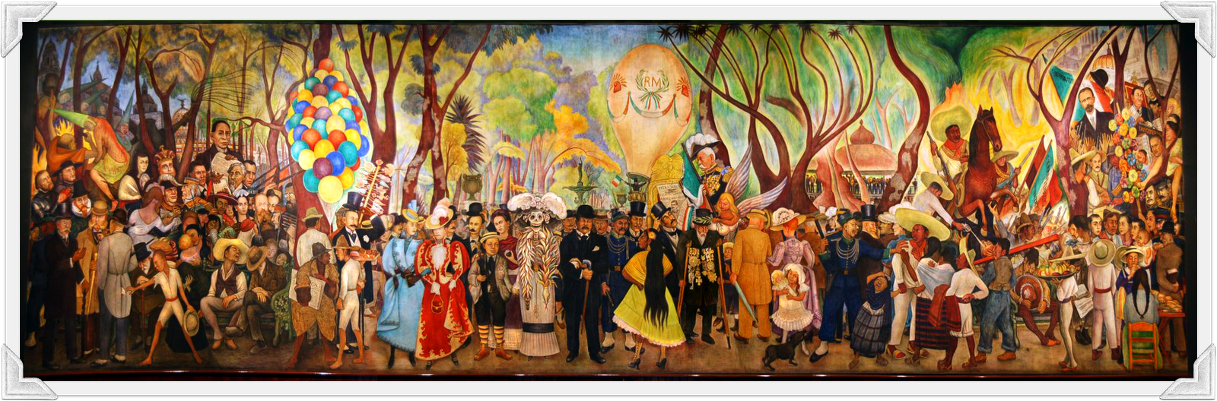
Prompt: What is an important idea from this text? Start by stating your claim. Support your claim and come to a consensus.
TEACHER VISUAL TEXT
Notes:
Display the Student Visual Text
Direct students to use their Think Time

Slide 42
Listen to the Model Constructive Conversation
  Use your think time to study the visual text.
Listen actively to what two partners say to each other.
Notes:
Provide a copy of the Model Script to the volunteer and allow time beforehand for student to review the script. Suggestions for reading the script:
● Show a video of students having the model conversation (optional)
● Model with a student using the Model Script.

Slide 43
Visual Text Model
What is an important idea from this text? Start by stating your claim. Support your claim and come to a consensus.
Partner A: An important idea from this text is that if politicians want to get elected they need to promote themselves. What is your idea?
Partner A: I think the politician is campaigning to get elected. I notice there is a hot air balloon with Mexican flags decorating it. I also notice initials on the hot air balloon. He is the person riding the balloon. How can you support your idea?
Partner A:I think the rest of the people are supporting the politician by bringing their own flags and by joining them in the campaign. What other evidence do you have for your claim?
Partner A:I think that to get elected politicians need to campaign/advertise around the town. Can we come to an agreement?
Partner B: An important idea from this text is that parades can be entertaining for the people in a town.
Partner B:I think the women, men and children wearing fancy clothes are part of the parade. There are also people wearing costumes. They are all providing the spectators with entertainment. What evidence do you have for your idea?
Partner B:I agree with you that politicians need to promote themselves to get elected. I think they are using the parade to both entertain the bystanders and to promote their campaign.
Partner B: The important idea we came to a consensus on is that politicians can encourage people to vote for them by having a parade.

Slide 45
Listen to the Non-Model Constructive Conversation
  Use your think time to study the visual text.
Listen actively to what two partners say to each other.
Notes:
Provide a copy of the Non-Model Script to the volunteer and allow time beforehand for student to review the script. Suggestions for reading the script:
● Show a video of students having the model conversation (optional)
● Model with a student using the Non-Model Script.

Slide 46
Visual Text Non- Model
What is happening in this visual text. Provide evidence from the text to support your claim.
Partner A: I notice the people in the street having fun. They are on a Halloween parade. What do you notice?
Partner A: I notice costumes and people wearing gowns, suits and some wearing regular clothes. What do you notice?
Partner A: I know people are in costume.
Partner A: I see that people are just standing around and I see balloons.
Partner B: What I see happening in the visual text is people from a town posing for a picture.
Partner B :People have hats and gowns. They look like they are going to a party and they are all standing waiting for the picture.
Partner B: When it’s Halloween I like to dress up.
Partner B: No turn taken

Slide 47
Constructive Conversation Game
PROMPT:
What is an important idea from this text? Start by stating your claim. Support your claim and come to a consensus.
Rules of the game:
Each of you needs 1 CREATE, 1 CLARIFY, 1 FORTIFY, and 2 NEGOTIATE cards
Each of you will play one card as you share an idea. You will continue taking turns until all cards are placed in the middle.
If you’re done early repeat the process for an additional round.
Remember to use the Constructive Conversation Norms and Skills as you play the game.
Notes:
You are now going to have the opportunity to practice the Constructive Conversation Skill NEGOTIATE while playing a game.
Explain the rules of the Constructive Conversation Game to students.

Slide 48
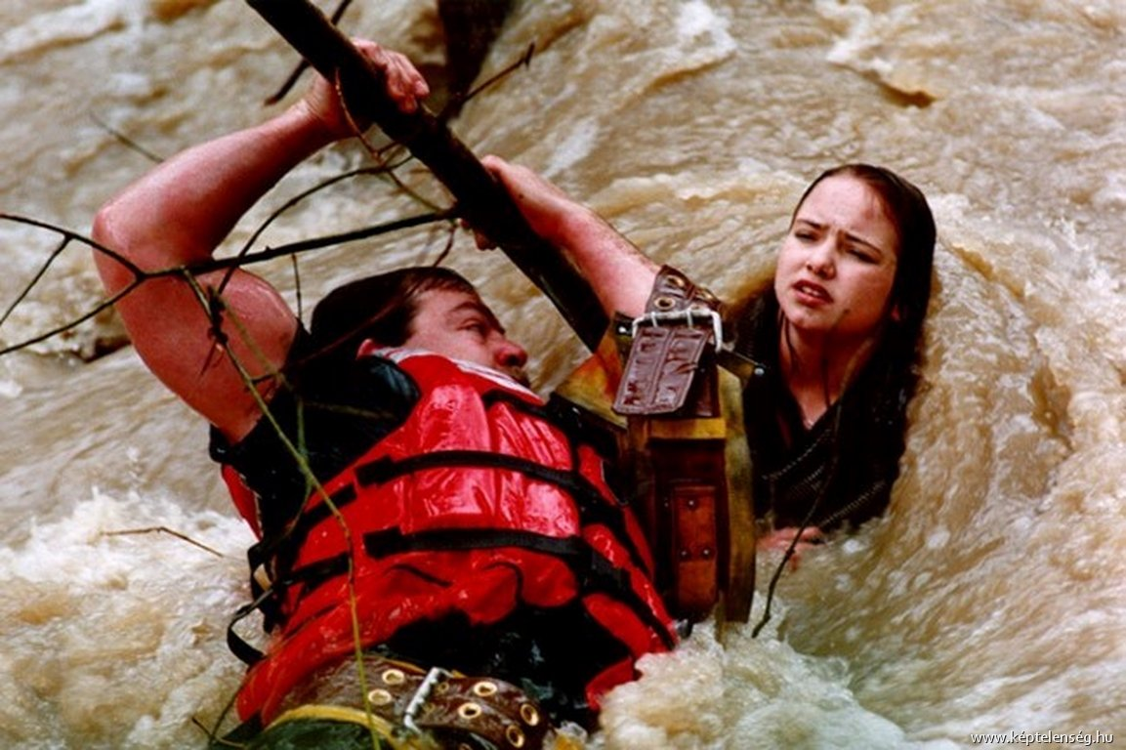
Prompt: What is an important idea from this text? Start by stating your claim. Support your claim and come to a consensus.
TEACHER COLLECTS LANGUAGE SAMPLE SPF 1.0
STUDENT VISUAL TEXT
Notes:
Display the Student Visual Text
Direct students to use their Think Time
As the students play the game, the teacher listens and selects two students who will replay the game in front of the class to serve as models.
This is an opportunity to capture a language sample.

Slide 49
CONSTRUCTIVE CONVERSATION
FISHBOWL MODEL
PROMPT: What is an important idea from this text? Start by stating your claim. Support your claim and come to a consensus.
Listen actively to what two partners say to each other.
FORMATIVE ASSESSMENT– TEACHER COLLECTS LANGUAGE SAMPLE SPF 1.0
Notes:
The two selected students will replay the game in front of the class and serve as models.
Student Progress Form (SPF)-­‐‑ Constructive Conversation Language Sample The teacher will collect a language sample from the two students on the Student Progress Form (SPF)-­‐‑ Constructive Conversation Language Sample to be used in Lesson 2. The language sample must be at least four turns in length. (Each turn includes both Partner A and B sharing

Slide 50
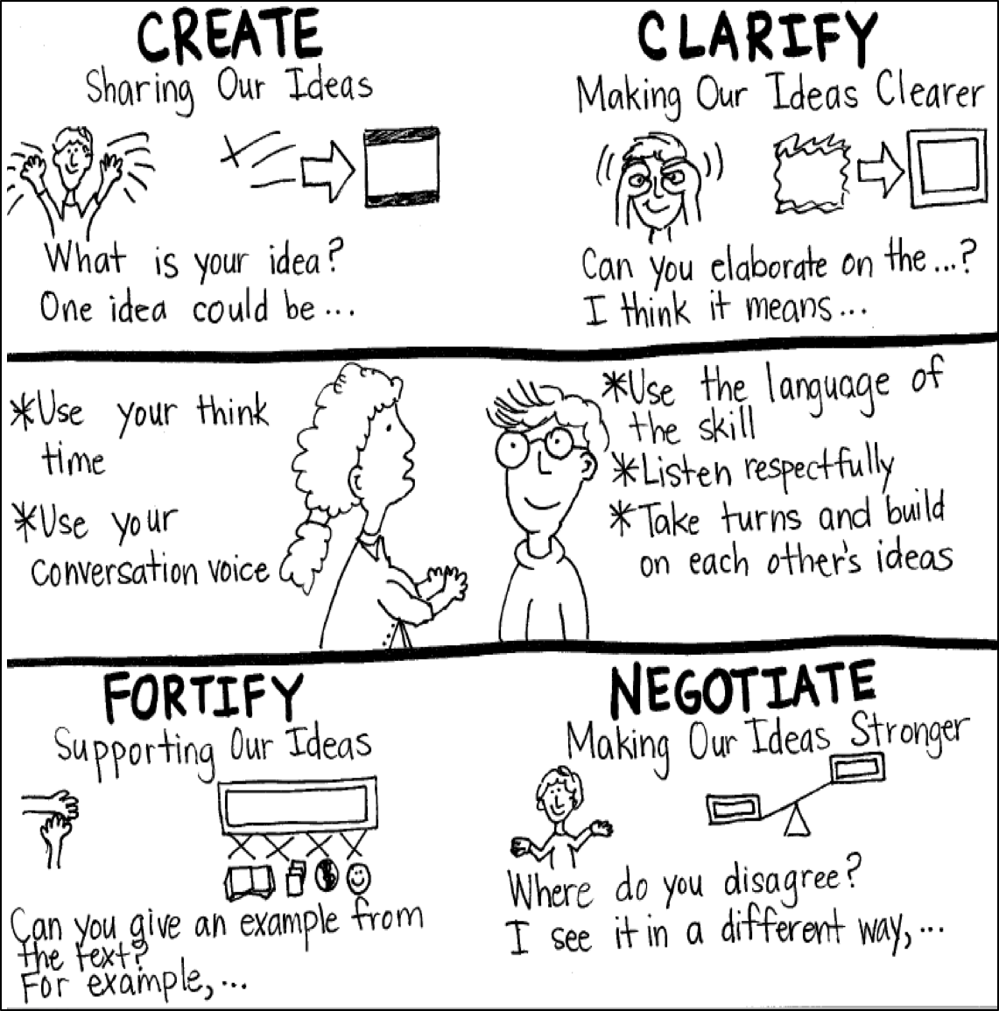
Model Creating Class Constructive Conversation Poster
Sample
Notes:
Teacher models creating a Constructive Conversation Poster. This slide is a resource. Teacher elicits student responses to help student develop a poster that illustrates their understanding of the NEGOTIATE skill and conversation norms.

Slide 51
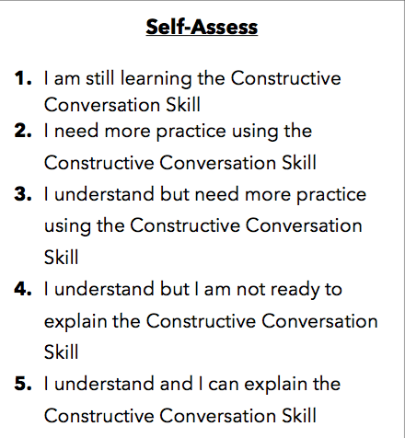
Notes:
Teacher will review the Constructive Conversation Skill NEGOTIATE
Students will self-assess answering the prompt
Teacher may select a conversation pair to share out.
EXAMPLE:
Student: I rated myself a 3 because…
Teacher: What can you do to move to a 4?

Slide 52
Teacher Resources

Slide 53
NEGOTIATE Non-Model Revision

